Slide 1
Internet business concepts Week #6: online business issues
October 2018 v2.1

Slide 2
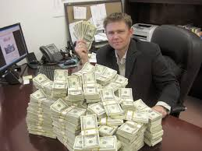
So you want to start an online business, eh?
That’s cool. Lots of people are doing it, making some side cash or to get around the problems with owning a brick-and-mortar business.
But don’t think that it’s as easy as buying a domain and paying for monthly hosting. You still gotta hustle & earn your living.
“Look at all this money I made using Facebook!”

Slide 3
Fact: it’s still easy to make a business online
PROS:
The barriers to entry are low – if you know how to code, design & write, you can make a simple website.
If you think up a hot idea, it can market itself – glitter bombs in the mail, Etsy stores, online courses, boutique products & services, etc.
Low overhead – no rent, no employees, online 24/7

Slide 4
Well, alright! I like money, let’s do this!
Not so fast buckaroo. There are CONS:
Finding that killer idea is tough – We’re 20 years into the mainstream internet era. Lots of competition now exists.
Viral content is hard to generate – if it were easy, everyone would be doing it. You need to experiment & sometimes move on. 99.99% of the time, you need to market your website.
Obstacles await – need new content but are too tired to write it? Need to learn SEO? Need to understand more tech/IT? And let’s not forget about the joys of being a business owner…

Slide 5
let’s back up & talk about basics: the domain
Here’s what you need to just get started building an online business:
Domain Name: Something memorable, something descriptive, something that establishes your mental homebase
What do I mean by “mental homebase”? YOUR BRAND. YOUR ONLINE IDENTITY.
Are you funny? Are you serious? Are you building brand identity from scratch or informing people with descriptive brand?

Slide 6



EXAMPLE: THE EARLY DAYS OF MOVIE WEBSITES
Do these brands tell you what to expect when you visit that site?

Slide 7






Today’s top movie websites
What about these domains? Do they tell you more about what you can expect?

Slide 8
What’s the difference between then & now?
The online movie news website industry got competitive. Lots of people wanted to write about movies & make money from it.
As time went on, the domain names started veering towards being more descriptive for the website’s VALUE OFFERING, or what’s UNIQUE to that brand.
Slashfilm = /, which means something online about film
Coming Soon.net = straightforward & they couldn’t buy the .COM
IMDB = Internet Movie Database acronym
Screenrant = we discuss/debate movies

Slide 9





internet culture has matured
My recommendation is that your DOMAIN NAME needs to have some ingredient of what your business offers, even if it’s a weird/bespoke name that you’re choosing.
2-3 INGREDIENTS SEEM TO WORK BEST
Examples: loads of startups/eComms from the 2010s

Slide 10


By this token, did hootsuite work?
If you had never heard about Hootsuite before, would you assume that it was a tool used to make a company’s life easier using social media/Twitter?
=
?

Slide 11
This is why it’s not all about the domain
Mediocre, even bad domains can turn into successful brands. It can be harder to accomplish, but it happens.
Other factors that go into it:
How hard you market
The value of your product
Resources (manpower, investment)
Competition, awareness of problem/pain you’re solving
Hustle/grit to overcome obstacles
And a little bit of luck

Slide 12

let’s back up again & talk about basics: the server you choose
Your Host: Good online reputation. Low downtime. Affordable for your current income (i.e. zero), but can work with you on scaling up when the time comes. Decent support.
SEO Consideration: You want a server that loads your site fast (and that’s after you’ve optimized it for loading as best as you can).

Slide 13
Good online business industries
I can reduce online business opportunities down into 3 categories:
Your Passion: It’s what you love to do.
Your Knowledge: It’s doing what you know better than 99.9% of everyone else.
Your Cunning: It’s picking something that requires the least amount of your effort, but gets good enough results to continue on with.

Slide 14
Passion-based industries
Loving what you do, no matter what you earn. Growth is on your mind & you’d like to earn more, but you look forward to your work.
In the Real World: Teaching, the majority of Artists, Journalists, some retail, small business owners/entrepreneurs.
On the Internet: Hobby websites, the majority of Etsy/eBay stores, flippers, equity startups.
POOR-LOW-MEDIUM SALARY EXPECTATIONS. LOW-MEDIUM WORKLOAD.

Slide 15
KNOWLEDGE-based industries
Your parents taught you the trade, or you learned how to do it through trial-and-error. You put in the time, now you make a living from it.
In the Real World: Specialized teaching, cooks, tradespeople, web dev & IT, small-medium sized businesses, real estate.
On the Internet: “I’ll teach you how to be rich” gurus, online courses, ebooks, service-based websites.
MEDIUM SALARY EXPECTATIONS. MEDIUM-HIGH WORKLOAD.

Slide 16
CUNNING-based industries
You maximize your time to produce the least required effort, for the highest possible yield (usually money).
In the Real World: Certain Hollywood types, probably those Shark Tank people, the 1%, runaway capitalists
On the Internet: Automated websites that require little, if no, maintenance.
MEDIUM-HIGH SALARY EXPECTATIONS. LOW-MEDIUM WORKLOAD.

Slide 17

Great, so now everyone wants to be the last of the 3 categories
It’s not easy to discover the next big thing that will make you rich.
What you want to do is MAXIMIZE your chances. And that usually involves looking at your internet business idea from each of the 3 perspectives.
PASSION: Will people be interested in my idea?
KNOWLEDGE: Does my idea provide value?
CAN IT BE SCALED UP: Do I have to be there all the time?
Note that I’m asking these questions about/to my audience & not myself anymore.

Slide 18
7 Examples of online businesses…from 2008
http://www.mikes-marketing-tools.com/marketing-tips/7-business-success-stories.html

Slide 19
7 Examples of online businesses…from 2015
Andy Weir’s ebook “The Martian” is the #1 movie in October 2015
“Darkest Dungeon”, a Vancouver-made video game, is #1 on Steam for weeks
Matt Astifan is a local affiliate marketer with an “internet masterminds” group
MySpace is dead but Wordpress themes are sold all across the internet
You’ve seen someecards. Here’s where he was in 2008. Now it’s about memes.
Markus Frind sold for Plenty of Fish for $575 mm USD. Was it because of Tindr?
And domains are still selling for stupid money.

Slide 20
7 more Examples of online businesses… from october 2018
The Scathing Atheist is getting $3,400/month from Patreon
Scott’s Cheap Flights sells a weekly newsletter & makes $113,245/month (est)
Couponing101 sold their website for $41,000
Rare Playing Cards sells…well, rare playing cards
Northern Parrots is an example of a website that sells for just 1 kind of thing
An online cake decorating course has made over $18,000
And this one is all about treadmills. Here’s more info about the site.

Slide 21

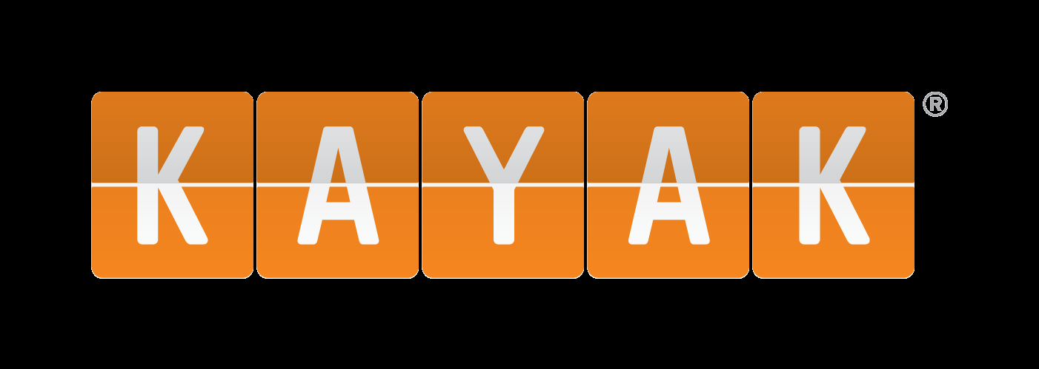

Practical categories
eCommerce is still big. Look at Shopify’s success stories page for examples of diversity and variety of eComm stores.
Affiliate sales: convincing other people to buy third-party services or goods. Internet marketing gurus seem to use this as their primary revenue stream.
But not all affiliate sites follow the same path: for example, Kayak.com.
Building a site to sell your unique service or product. Web dev/design or SEO (crowded markets, but can you offer a unique value?)

Slide 22
Homework assignment!
Create your own online business idea. Describe it in about 50 words.
Develop 3 possible domain name ideas. Discard 2 and select your top choice. Write 1 sentence description explaining your top choice, and sentences explaining why you didn’t pick your 2 discarded choices.
Research & select a hosting company. Again, pick 3 candidates and 1 final choice. Provide a sentence description explaining your top choice & why, and why you ultimately chose to not use the other 2.
Explain your online business idea:
Who is your audience?
What value are you providing?
Is your market mature & competitive, or new & unexplored?
Any other important details that make your business stand out?
MINIMUM 350 WORDS FOR TOTAL ASSIGNMENT!

